Slide 1




University Institute of Engineering
Department of Computer Science & Engineering
COMPUTER ORGANIZATION & ARCHITECTURE
(23CST-204/23ITT-204)
ER. SHIKHA ATWAL
E11186
ASSISTANT PROFESSOR
BE-CSE

Slide 2
Parallelism in Uniprocessor Systems
A uniprocessor (one CPU) system can perform two or more tasks simultaneously. The tasks are not related to each other. So, a system that processes two different instructions simultaneously could be considered to perform parallel processing.

Slide 3
Example
Example of Uniprocessor System is the instruction pipeline is similar to a manufacturing assembly line. If the assembly line is partitioned into four stages: The first stage receives some parts, performs its assembly task, and passes the results to the second stage; the second stage takes the partially assembled product from the first stage, performs its task, and passes its work to the third stage; the third stage does its work, passing the results to the last stage, which completes the task and outputs its results. As the first piece moves from the first stage to the second stage, a new set of parts for a new piece enters the first stage. Ultimately, every staged process a piece simultaneously. This is how time is saved and this is an example of parallelism in uniprocessor.

Slide 4
Introduction to parallel Processing Parallelism
Parallel processing is a term used to denote a large class of techniques that are used to provide simultaneous data-processing so as to provide fast computational speed of a computer system.
Instead of processing each instruction sequentially as in a conventional computer, a parallel processing system is able to perform concurrent data processing to achieve faster execution time.
The purpose of parallel processing is to speed up the computer processing capability and increase its throughput, i.e., the amount of processing that can be accomplished during a given interval of time.

Slide 5
The amount of hardware, needed for parallel processing and the cost of the system is more, as compared to normal computer.
Parallel processing has various levels of complexity. At the lowest level, we distinguish between parallel and serial operations by the type of registers used, e.g., Shift registers operate in serial fashion one bit at a time, while registers with parallel load operate with all the bits of the word simultaneously.
Parallel processing at a higher level of complexity can be achieved by having a multiplicity of functional units that perform identical or different operations simultaneously. Parallel processing is established by distributing the data among the multiple functional units. For example, the arithmetic, logic, and shift operations can be separated into three units and the operands diverted to each unit under the supervision of a control unit.

Slide 6
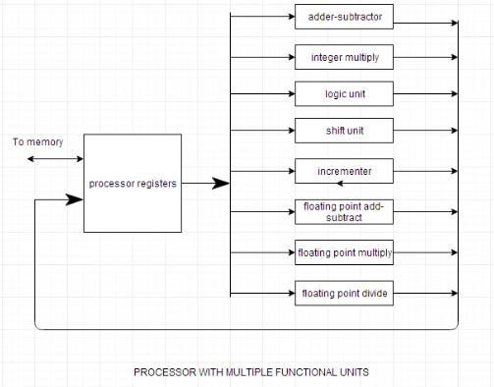

Slide 7
One possible way of separating the execution unit into eight functional units operating to adopt parallel processing, is shown in the figure. The operands in the registers are applied to one of the units depending on the operation specified by the instructions associated with the operands. The operation performed in each functional unit is indicated in each block of the diagram.
The adder and integer multiplier perform the arithmetic operations with integer numbers. The floating-point operations are separated into three circuits operating in parallel. The logic, shift, and increment operations can be performed concurrently on different data. All units are independent of each other, so one number can be shifted while another number is being incremented. A multifunctional organization is usually associated with a complex control unit to coordinate all the activities among the various components.

Slide 8
FLYNN'S CLASSIFICATION
Michael J. Flynn proposed a scheme for classifying computer organisations in 1996.
Flynn's idea for the classification of computer organizations stated that based on the number of simultaneous instruction and data streams used by the CPU during a program execution, digital computers can be classified into four categories. This is popularly known as Flynn's classification of computer architecture.
According to Flynn, the four classifications of digital computer are:
SISD or Single Instruction Stream-Single Data stream.
SIMD or Single Instruction Stream-Multiple Data stream.
MISD or Multiple Instruction Stream-Single Data Stream,
MIMD or Multiple Instruction Stream-Multiple Data Stream,

Slide 9
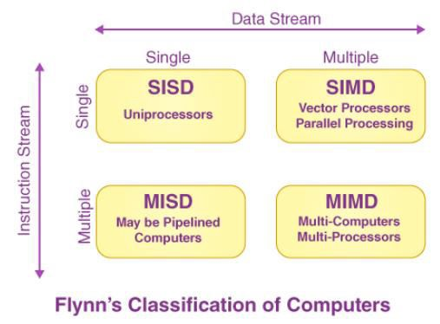
Understanding a few terms used above:
Stream: Stream refers to a sequence of objects (which may be data or instructions) that is executed by a single CPU.
Instruction Stream: Instruction stream refers to the sequence of instructions that are executed by the CPU.
Data Stream: Data stream refers to the sequence of data including input, partial or temporary results called for by instruction stream.
Instructions and data are fetched from memory modules. Data streams flow bidirectionally between processor elements and the memory. Flynn's classification is based on the multiplicity of instructions and data streams in a computer system.

Slide 10
SISD Architecture
The full form of SISD is Single Instruction Stream—Single Data Stream.
In the SISD computer architecture, instructions are executed sequentially but may overlap in their execution stages. In other words, the pipelining technique is applicable to the CPU.
Modern-day SISD uniprocessor systems are mostly pipelined. An SISD computer may have more than one functional unit in it, but all are under the supervision of one control unit. SISD- architecture computers can process only scalar-type instructions.
Most serial computers available today follow the SISD architecture. Given below is the diagram depicting the SISD computer architecture.

Slide 11
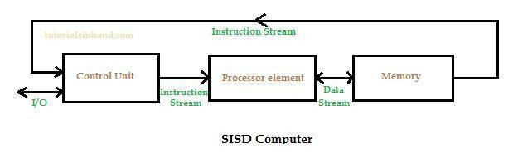
Examples of SISD computers
SISD computer using one functional unit: IBM 701, IBM 1620, and IBM 7090
SISD computer using multiple functional units: IBM 360/91, CDC Star-100, and TI- ASC

Slide 12
SIMD Architecture
SIMD, in its full form, is Single Instruction Stream—Multiple Data Stream.
In a SIMD computer, we can see from the below diagram that there are multiple processing elements supervised by the common control unit.
All the processing elements, which are ALUs, receive the same instruction broadcast from the control unit but operate on different data sets from distinct data streams. As seen in the diagram, the control unit sends a common instruction stream to each processor element. The shared memory sub-system containing multiple modules is very essential.
Given below is a SIMD architecture diagram:

Slide 13
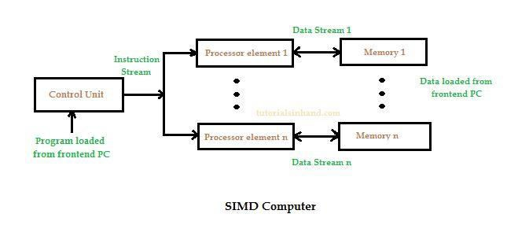

Slide 14
Features of SIMD architecture
Given below are important features of SIMD architecture:
SIMD architecture introduces concept of parallelism which can execute multiple data sets based on single instruction.
SIMD computer is used to process vector type data.
SIMD architecture is suitable in tasks like multimedia processing (video, audio, image processing), cryptographic algorithm, matrix multiplications, etc.
Array processor falls into SIMD computer.
Example of SIMD computer
Illiac-IV, PEPE, BSP

Slide 15
MISD Architecture
MISD full form is Multiple Instruction stream-Single Data stream. It indicates that multiple instructions are applied to the same set of data.
MISD architecture is also known as systolic arrays.
MISD is one among the four machine that falls under the Flynn's classification of computer. Other three are SISD, SIMD and MIMD computers.
In MISD computer architecture:
there are n processor elements.
Each processor elements receives distinct instructions to execute on the same data stream and its derivatives.
Here the output of one processor element becomes the input of the next processor element in the series.
MISD architecture is a theoretical architecture and rarely applied in practical systems. Given below is the diagram of MISD architecture:

Slide 16
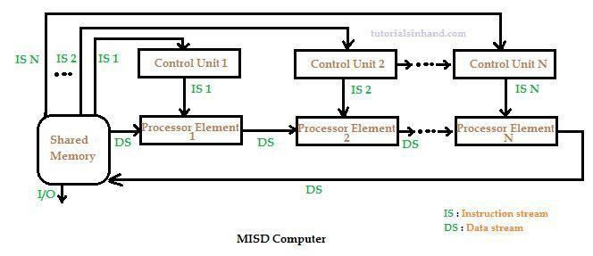
MISD architecture is not that popular though some fault tolerance machines can be used in this class.
Examples of MISD computer
No practical machine of MISD class exists.

Slide 17
MIMD architecture
MIMD full form is Multiple Instruction Stream-Multiple Data stream.
MIMD computer is one among four of the Flynn's classification of computer. Other three are SIMD, SISD, MISD computer.
MIMD computer category covers multiple computer system and multiprocessor systems. MIMD computer is of two types:
tightly coupled or Uniform Memory Access (UMA): MIMD computer is called tightly coupled or Uniform Memory Access (UMA) if the degree of interaction among the processor is high.
loosely coupled or Non-Uniform Memory Access (NUMA): MIMD computer is called loosely coupled or Non-Uniform Memory Access (NUMA) if the degree of interaction among processors is low.
Given below is the MIMD computer architecture diagram:

Slide 18
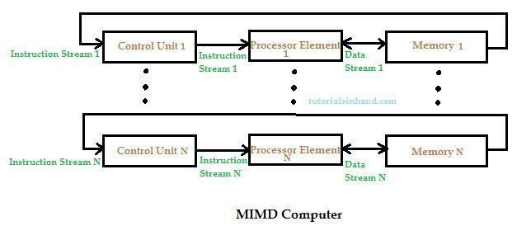
Example of MIMD computer
MIMD loosely coupled examples: IBM 370/168 MP, Univac 1100/80
MIMD tightly coupled examples: C.mmp, Cray-3, S-1, Cray-X MP

Slide 19
References
Reference Books:
J.P. Hayes, “Computer Architecture and Organization”, Third Edition.
Mano, M., “Computer System Architecture”, Third Edition, Prentice Hall.
Stallings, W., “Computer Organization and Architecture”, Eighth Edition, Pearson Education.
Text Books:
Carpinelli J.D,” Computer systems organization &Architecture”, Fourth Edition, Addison Wesley.
Patterson and Hennessy, “Computer Architecture”, Fifth Edition Morgaon Kauffman.

Slide 20
Other References:
https://www.scribd.com/doc/14716458/Parallelism-in-Uniprocessor-System-and-Granularity
https://brainly.in/question/6662076
Parallel Processing and Data Transfer Modes | Computer Architecture Tutorial | Studytonight
https://tutorialsinhand.com/tutorials/computer-organization-and-architecture-coa- tutorial/flynns-classification-of-computers/flynns-classification-of-computers.aspx
https://www.geeksforgeeks.org/computer-architecture-flynns-taxonomy/
http://www.brainkart.com/article/Flynn-s-Classification_8627

Slide 21
Video Links:
https://youtu.be/rBdk_hDnQb0?si=Z38PMmgYAmTDdAhR
https://youtu.be/dHrOzNf55fs?si=QrJOJ4-f_FaY1bJx
https://youtu.be/txAyA_UozmM?si=K3hsnLCTZpXXKiP1
https://youtu.be/D7UK46gXhcA?si=DfQDir9yhrPpB3n5
https://youtu.be/qgbt9mrQ7Gs?si=bsGG9yIqfn5ffRYM

